Slide 1
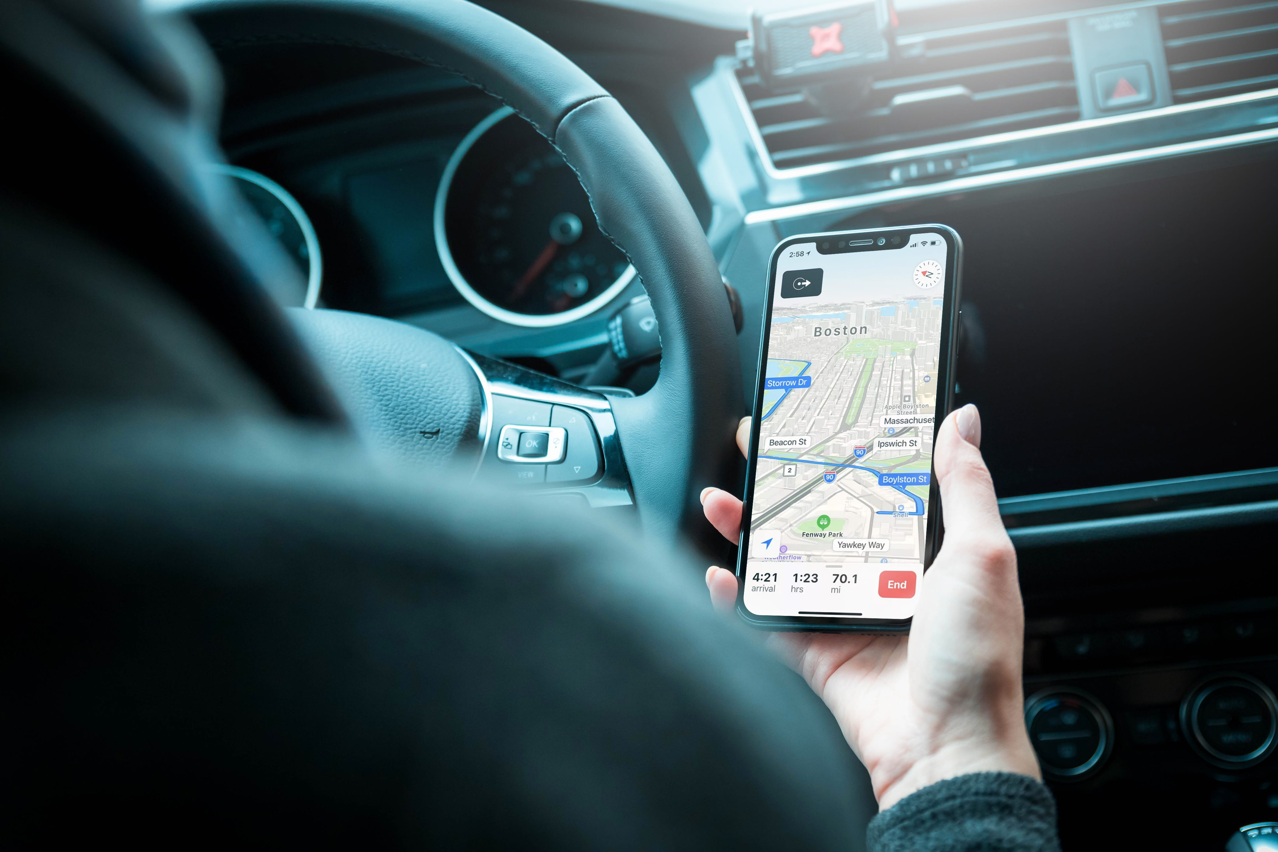







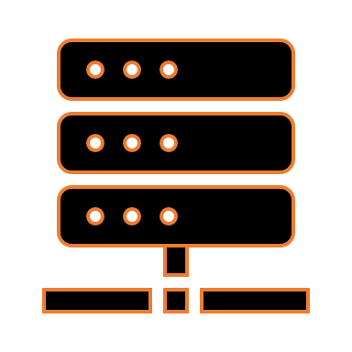

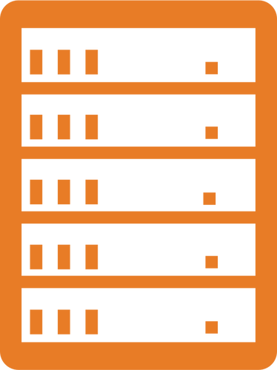
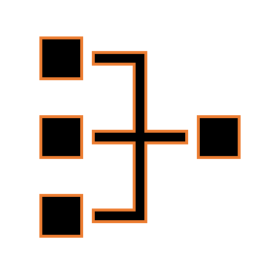

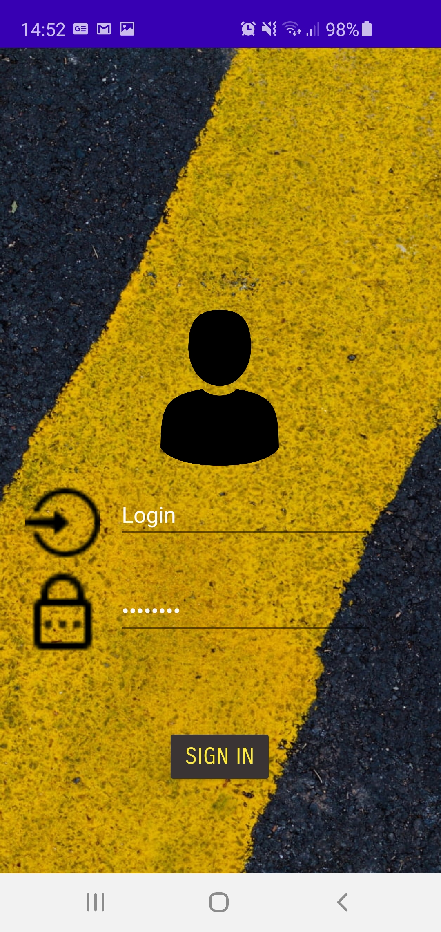
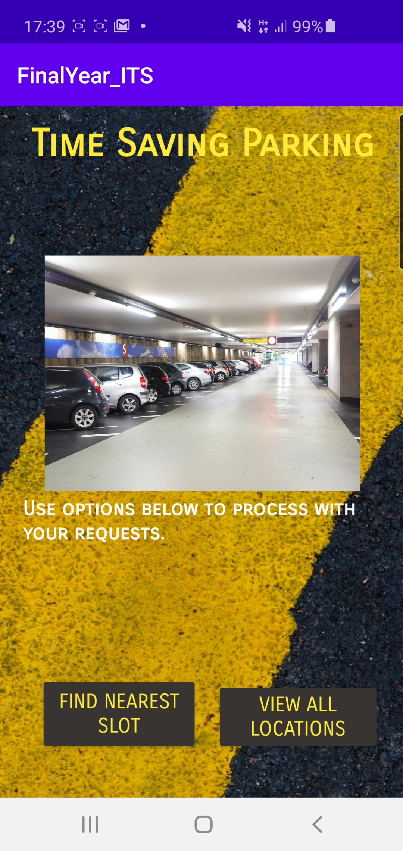
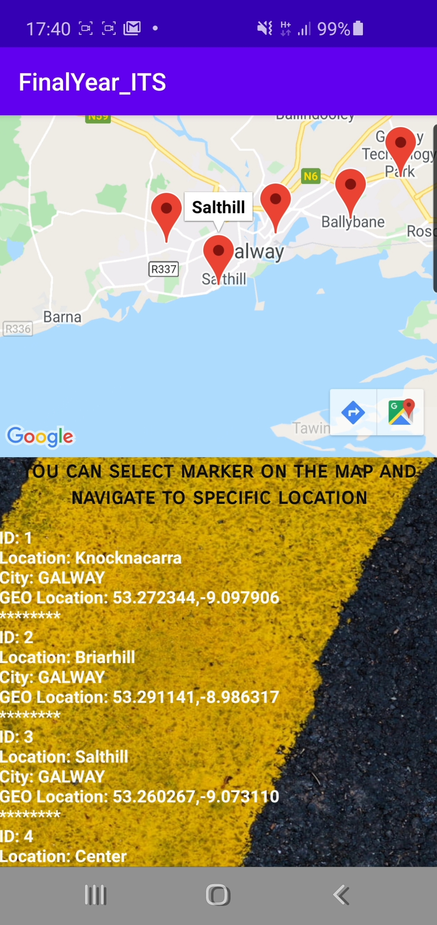
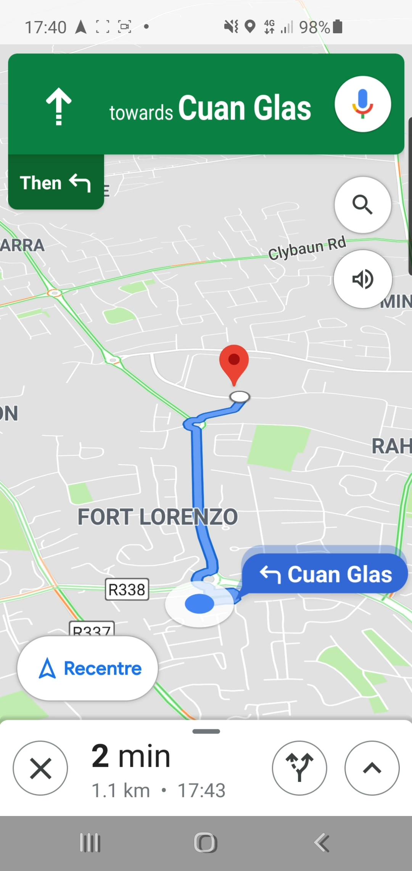

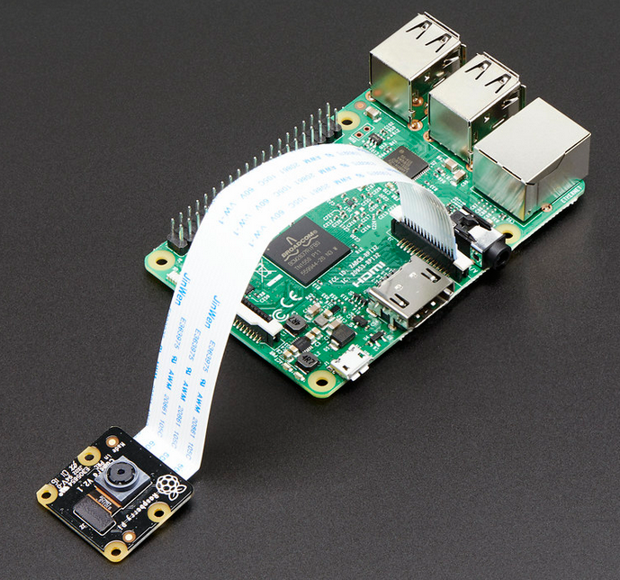
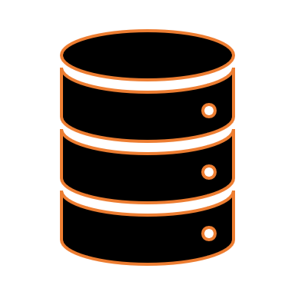
Arvids Ceceruks
BEng(Honours) in Software and Electronics Engineering
Year 4
“Time Saving Parking”
Parking slot finder system
Project Overview
Android Mobile App
Android Mobile App
(Client)
A project is designed to assist users of a mobile app to locate nearest parking slots and save their time looking for one. User, through a mobile app interface can log in and send request to receive location of a nearest parking slot available in real time.
The application, developed in Android Studio using Java , provides user friendly interface. To use application, person must log in using own credentials that are stored in database. When logged in , all features of mobile application are accessible where person can see information about carpark locations, request to find nearest parking slot and provide navigation to slot location.
Database
MariaDB/MySQL
Http Request
MySQL Queries
REST API Web Server
REST API Web Server
The server, developed using Spring Boot, Java and Embedded Tomcat processes incoming requests from devices, and queries the Database(MySQL) accordingly.
Http Response
Http Response
The System
Raspberry Pi & Camera
Application
The system consists of three main components:
REST API Web Server
RaspberryPi 4 & PiCamera
Android Mobile App
Developed system is applying computer vision to detect empty parking slots where system have been implemented. Raspberry Pi is taking images, processing them and sends request containing information regarding current location to the RESTful service.
Raspberry Pi 4 & Pi Camera
Advantages
Http Request
Low cost implementation
Flexibility in use (Hence user interface is provided)
Access from any device with internet connection and geo sensor.
‘Pay as much, as you use’ can be implemented.
Innovative replacement for parking pay machines
Database
Login
Options
Information
Navigation
Is a MySQL database developed in HeidiSQL. Architecture of it is designed as relational database and consists of set of tables.

